Slide 1
To-do List for Multi-User
University of Washington – Bothell
Distributed Computing
May 25. 8:40 PM
Yiwei Tu
Jiaqi Zhan
Mengxuan Wang

Slide 2
Agenda
Background
Functionalities
Error handling
Client Flow
Architecture
Technologies
Demo
Add & Cuts
Enjoy & Difficulties

Slide 3


Background
Traditional To-do List
Single user
Only one list per time
Multiple tasks
Multi-User To-do List
Able to share lists with others
Multiple lists to manage
Multiple tasks in one list

Slide 4
Functionalities and Handling Error Scenario-User Service
User Service
New user registration
Existing user log in
Change password
Add User
Duplicate username
Invalid username
Invalid user password (empty or null)
Change password
Invalid username
Invalid old password
Invalid new password
Username and old password not match
New Password and old password are identical
Login
Invalid username
Invalid password
Username and password not match

Slide 5
Functionalities and Handling Error Scenario-List Service
List Service
Add a new list
Check user access to a list
Grant a user access to a list
Remove a user access to a list
Show all lists accessible by a user
Show all accessible users for a list
Delete a single list
Delete all the lists accessible by a user
Add List
Check Access
Add duplicate list
Check non-exist list
Delete List
Grant Access
Delete non-exist list
Grant non-exist user
Grant granted user
Get Lists
Remove Access
Get list from non-exist user
Remove ungranted user
Remove user himself/herself
Delete All Lists
Delete list from non-exist user

Slide 6
Functionalities and Handling Error Scenario-Task Service
Display All Task Names
Task Service
Unauthorized user display all tasks
Add Task
Unauthorized user add task
Add already-exist task
Add task to non-exist list
Get a Task
Add a task under a list
Show a task information
Show all tasks under a list
Update task content
Update task status
Delete a task
Delete all tasks under a list
Unauthorized get task
Get non-exist task
Delete Task
Update Task Status
Unauthorized user update task status
Update to invalid task status
Unauthorized user delete task
Delete non-exist task
Delete All Tasks
Update Task Content
Unauthorized user delete all tasks
Unauthorized user update task content

Slide 7
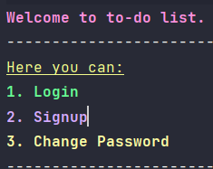
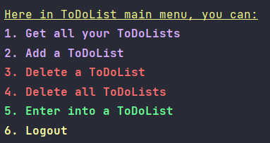
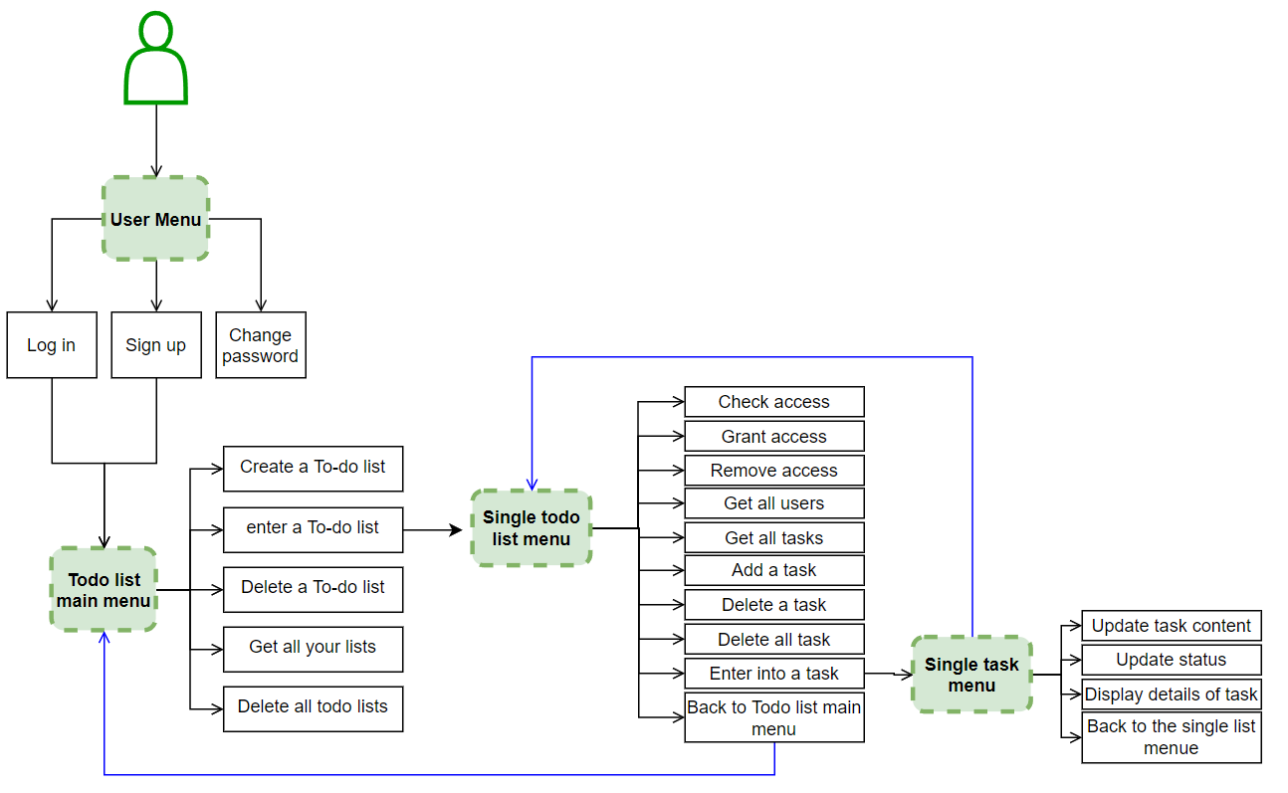
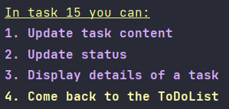
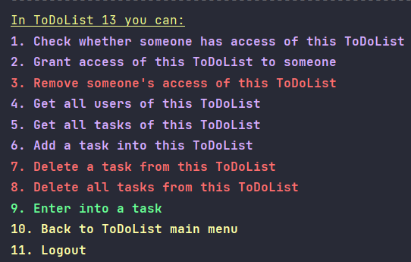
Client Flow

Slide 8
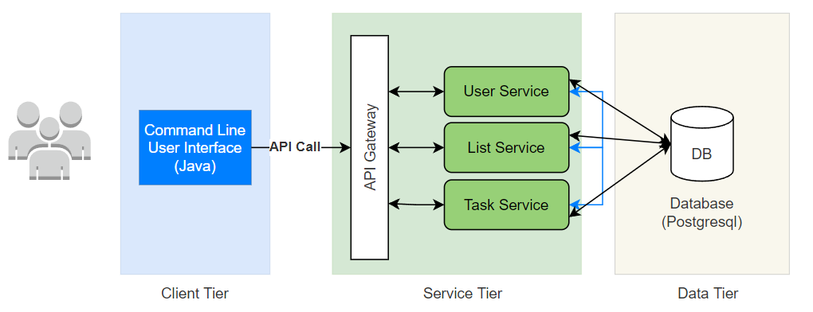
Architecture

Slide 9
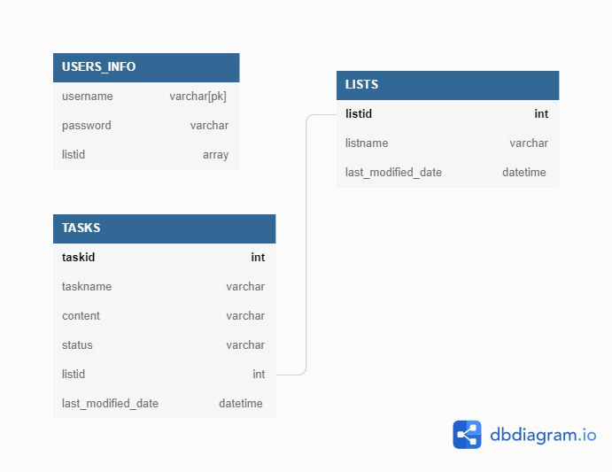
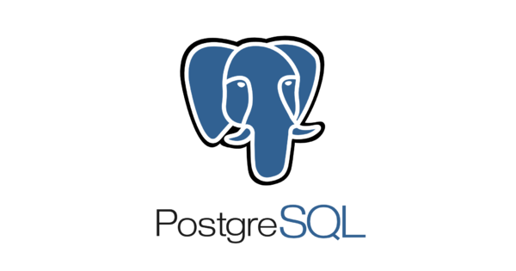
Database

Slide 10
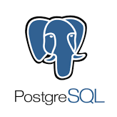

Technologies
Entire Project : Java
Client-Server:
HttpClient, HttpRequest, Jackson, JSONObject
Services
Dropwizard
Service-Database: JDBC
Database: Postgresql

Slide 11
Demo

Slide 12
Adds & Cuts
Adds
Extend the number of display lists from top 5 to all lists for a user
Add “delete all tasks” function
Use array to store ids of lists accessible by a user
Cuts
Remove single user table and list table
Remove the ability to change taskname, since it is unique in a list

Slide 13
Takeaway – Yiwei Tu
Enjoyable
Painful
I love SQL! Enjoy learning and user Postgresql
Built services and saw them run successfully
Learn new technologies (http request in Java, json parsing, annotation, etc.)
Unfamiliar with gradle, Maven…
Dropwizard tutorial hard to find
Error handling and edge case handling
Integrate the pieces together

Slide 14
Takeaway – Jiaqi Zhan
Enjoyable
Painful
Learn how to handle HTTP request
Design the functionality of list and task components
Figure out the adding the postgres driver dependency of maven project
Learn the implementation of client

Slide 15
Takeaway – Mengxuan Wang
Enjoyable
Painful
Learned how to use Dropwizard framework to build a service from scratch easily
Learned how to build a Client service by thinking from the customer perspective
Learned a lot during the debugging process
Happy to see a solid distributed system can built by us successfully
There are many corner cases need to be considered
Limited resource about Dropwizard
Using Java to write the UI is heavy, next time better to use HTML, CSS and JavaScript to build Web UI instead

Slide 16
Thank you

